Slide 1
Chapter 1: Introduction to Public Speaking

Slide 2
Learning Objectives
After reading your chapter, you will be able to:
Articulate at least three reasons why public speaking skills are important
Describe the difference between the linear and transactional model of communication.
List, define, and give an example of each of the components of communication.
Identify the eleven core public speaking competencies.

Slide 3
3 Benefits of Public Speaking
Public speaking benefits your personal life.
Public speaking benefits your professional life.
Public speaking benefits your public life.

Slide 4
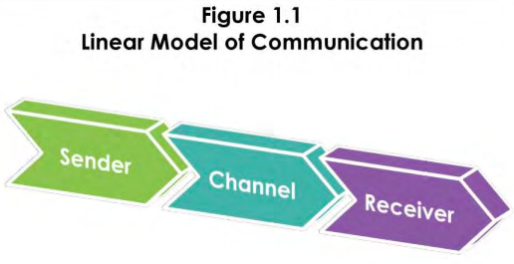

Slide 5
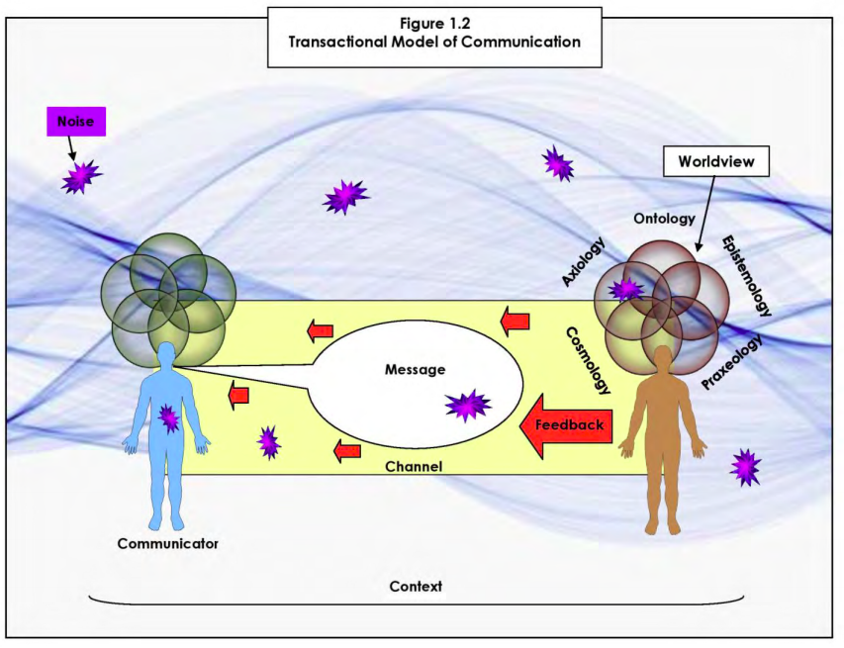

Slide 6
11 Core Competencies:
Useful topic
Engaging introduction
Clear organization

Slide 7
11 Core Competencies:
Well-supported
Closure in conclusion
Clear and vivid language

Slide 8
11 Core Competencies:
Suitable vocal expression
Corresponding nonverbals
Adapted to audience

Slide 9
11 Core Competencies:
Adept use of visual aids
Convincing persuasion

