Slide 1
Chapter 3: Speaking with Confidence

Slide 2
Learning Objectives
After this presentation you should be able to:
Understand the nature of communicative apprehension (CA), and be in a better position to deal with your particular “brand” of CA
Analyze objectively the formation of your habitual frame of reference
Apply cognitive restructuring (CR) techniques to create a more positive frame of reference
Understand the importance of customized practice to become conversant in your topic
Create a personal preparation routine to minimize your apprehension

Slide 3
Brainstorm
You’re giving a 10-min speech 8 min from now.
What feelings come to mind?

Slide 4
Communication Apprehension
“An individual’s level of fear or anxiety associated with either real or anticipated communication with another person or persons.”
- McCrosky, 1977

Slide 5
Rate Your Apprehension
A. Speech in a college class
B. Job interview
C. Party with strangers
D. Speech at a wedding
E. Presentation to coworkers
0 1 2 3 4 5

Slide 6
McCroskey’s Research Findings
20% High Trait Anxiety
80% Some Communication Anxiety
70% People have Public Speaking Anxiety

Slide 7
Types of Apprehension
Trait Anxiety
State Anxiety
Scrutiny Fear

Slide 8
List Symptoms of Apprehension
1.
2.
3.
4.
5.

Slide 10
Frame of Reference:
Assumptions that form the viewpoint from which one perceives and assesses situations.
Developed through experience.
Generates feelings.
Influences behavioral choices.

Slide 11
Frame of Reference:
Frame
Situation
Action
Consequence
Reinforcement

Slide 12
Cognitive Restructuring:
Identify your current thoughts
Identify distorted thoughts
Replace distorted thoughts with realistic thoughts

Slide 13
Examples of Cognitive Restructuring:
Everyone is staring at me.
They will look for mistakes.
They will see me as a loser.
I will be embarrassed.
Everyone is looking at me.
They will be interested in what I have to say.
They will appreciate the information and support my growth as a speaker.
I will succeed.

Slide 14
Change Your Public Frame:
__________
_________
_________
__________
________
Frame
Situation
Action
Consequence
Reinforcement

Slide 15
Building Confidence:
Prepare Well
Visualize Success
Avoid Gimmicks
Breath and release
Minimize what you Memorize
Rehearse Out Loud

Slide 16
Prepare Well:
Start early
Collect material
Create a preparation outline
Convert the preparation outline into a key phrase speaking outline

Slide 17
Visualize Success:
Visualization used by athletes and other performers
Enhances performance
Visualize
Your audience’s friendly faces
The smooth flow of your speech
Your confident posture
Your audience’s applause

Slide 18
Avoid Gimmicks:
Picturing audience in pajamas
Practicing in front of a mirror

Slide 19
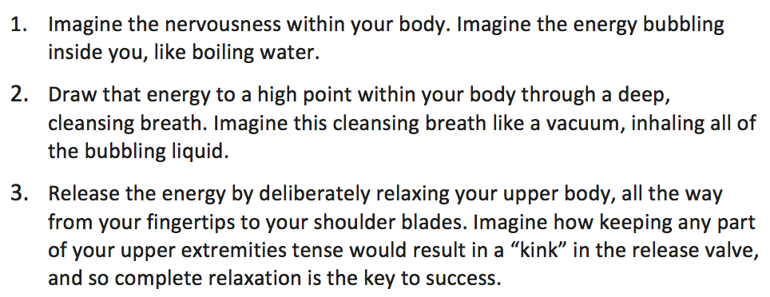
Breathe & Release Technique:

Slide 20
Minimize What You Memorize:
Memorizing is a different skill than extemporaneous speaking
Not required for this class
The aim is being conversant
Knowing your topic well enough to share it in an expressive and fluent way
Visualize telling a friend about your topic at a cafe

Slide 21
Rehearse Outloud:
Present your whole speech from beginning to end in private first.
Make adjustments to fit the time limit.
Continue to practice the edited speech.
If you can recruit friends or family, rehearse in front of them.
If you rehearse with an actual audience, you will reduce anxiety and increase confidence.
You can also get feedback to consider.

