Slide 1
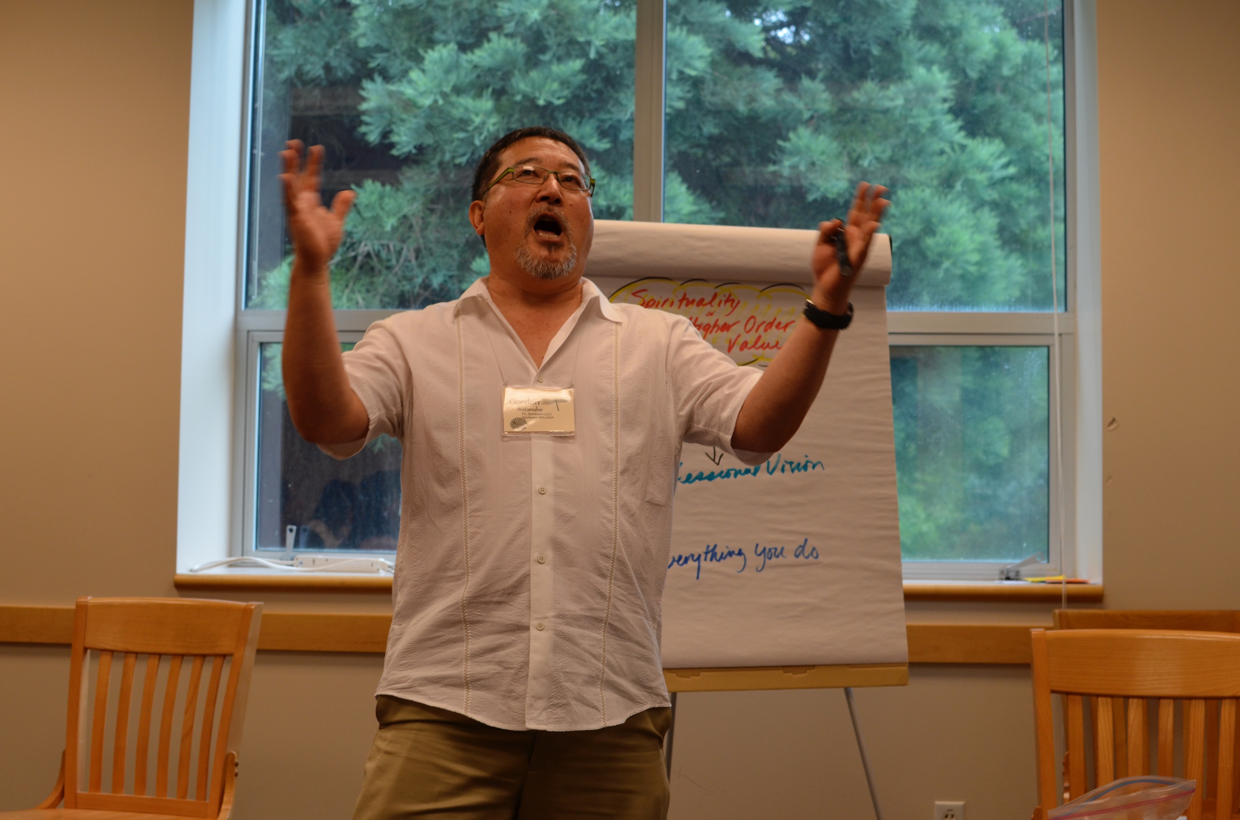
Chapter 3: Delivering Your Speech

Slide 2
Learning Objectives
After this presentation you should be able to:
Identify, define and give an example of each of the four main types of delivery
Determine the best speaking style for different types of speaking occasions
Identify and utilize voice aspects of speaking
Recognize and utilize the key “ingredients” of a well-performed speech
Adapt to the physical aspects of a speaking venue
Plan the speech in preparation for delivery/ performance of a speech.

Slide 3
Importance of Delivery:
Audience will stay alert and follow your speech
Audience will accurately interpret your meaning
Audience has a greater chance of experiencing the emotions you express

Slide 4
Keys to Mastering Delivery:
Preparation
Practice

Slide 5
4 Methods of Delivery:
MANUSCRIPT Prepared script read word for word | MEMORIZED Script recited from memory word for word
EXTEMPORANEOUS Prepared and rehearsed speech delivered using keynotes for reference | IMPROMPTU Speech delivered on the spot with little or no preparation

Slide 6
2 Components of Delivery:
Vocal/Verbal
Nonverbal

Slide 7
Components of Verbal Delivery:
Breathing
Articulation
Pronunciation
Pitch
Projection
Rate

Slide 8
Breathing

Slide 9
Articulation:
U, E, R Exercise

Slide 10
Pronunciation:
Proper pronunciation results from the production of:
Vowels
Consonants

Slide 11
Pronunciation Variations:
Accents
Regionalisms
Dialects

Slide 12
Pitch:
Highness
Lowness

Slide 13
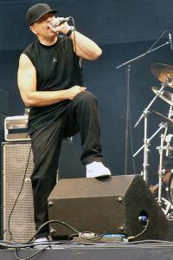
Dramatic Inflection:
A with musicalization
of the spoken word
to intensify meaning

Slide 14
Rate:
The tempo of speaking affects meaning and audience reception
Effective rate maintains attention
Can vary to emphasize meaning
Too fast clips words
Too slow lulls the audience to sleep

Slide 15
2 Kinds of Pauses:
Vocalized pauses in public speaking can
Distract
Annoy
Undermine credibility
Result from habit
Express lack of preparedness
Intentional Space between phrases
Highlights structure
Punctuates meaning
Time for reflection
SILENT
VOCALIZED

Slide 16
Effective Vocal Projection:
Erect Posture
Diaphragm Breathing
Energy
Warm up Exercises
Hum
Sing Scales
Yawn Loudly

Slide 17
Nonverbal Aspects of Delivery:
Personal Appearance
Movement
Gestures
Facial Expressions
Eye Contact
Sustained
Panoramic

Slide 18
Mastering the Location:
Room
Podium
Equipment
Water Rules

Slide 19
Preparing Speaking Notes:
Create a preparation outline
Convert to a speaking outline
Use only:
Key words
Key phrases

Slide 20
Rehearsal Checklist:
Rehearse a few days before you are to deliver your speech
Use the note sheets or cards you will be using for delivery
Practice with the presentation aids you will be using for delivery
Time your speech and cut or expand it if needed

Slide 21
Rehearsal Checklist:
Rehearse with a colleague or an audience if possible
If you can, rehearse in the room with the podium you will use
Plan what you will do with your hands
Plan and practice your opening and closing carefully, so you can deliver them exactly

Slide 22
Delivering Your Speech:
Approach the podium as you rehearsed
Stand with confident posture
Deliver your brilliant opening
Realize you are a hit with the audience
Breathe
Spontaneously interject a humorous observation related to your topic
Make all your points without hesitation
No “ums,” “likes,” or “uhs”

